Slide 1
Manhattan Project
‘s

Slide 2
MSD Tutorial
AVM
MBARC
META Software
CyPhy
Seed Design
Test Benches
Test Benches
FANG
Component Library
iFAb
CAD
Modellica
Components
Seed Design
Component Library
Documentation

Slide 3
Conventional V-Model
System
Validation
Concept
Product Definition
Demands
Deployment
High Level
Design
System
Verification
Detailed
Design
Unit
Testing
Development
&
Installation
Time

Slide 4
Modular V-Model
Concept
System
Validation
Product Definition
Demands
Deployment
High Level
Design
System
Verification
Detailed
Design
Unit
Testing
Developed
Parts
Time

Slide 5
OSE’s Problem
System
Validation
Concept
Product Definition
Demands
Deployment
High Level
Design
Developed
Parts
System
Verification
Time

Slide 6
OSE’s Problem
Prototype V.2.1
Monitor your Machine and Diagnose problems in the field
Concept
Product Definition
Demands
Deployment
High Level
Design
Developed
Parts
OSE never reaches a truly tested & validated design
Time

Slide 7
OSE’s Problem
System
Validation
Concept
Product Definition
Demands
Deployment
High Level
Design
Developed
Parts
System
Verification
Time

Slide 8
Solutions:
Simulation and Structural Analysis
Notes:
By building the CAD model and meshing the part it became very evident that the pivot would not work properly. The current drafting tool, Google sketchup, is not an effective tool to model the machine.

Slide 9
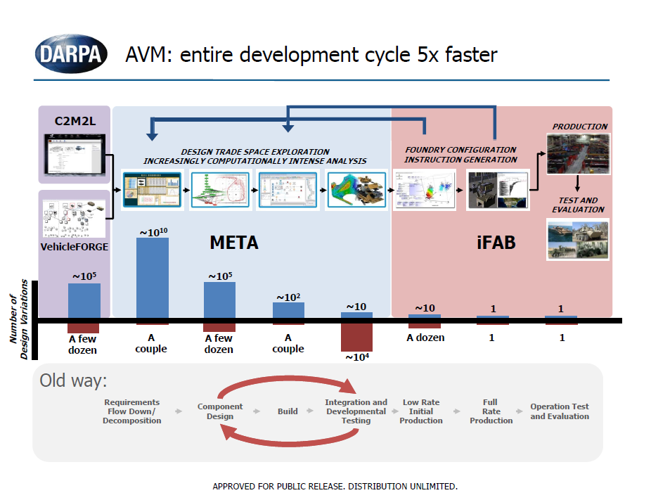
# of Virtual Model Simulation Iterations
Concepts
# of Prototypes Built
Lots of Prototype Testing

Slide 11
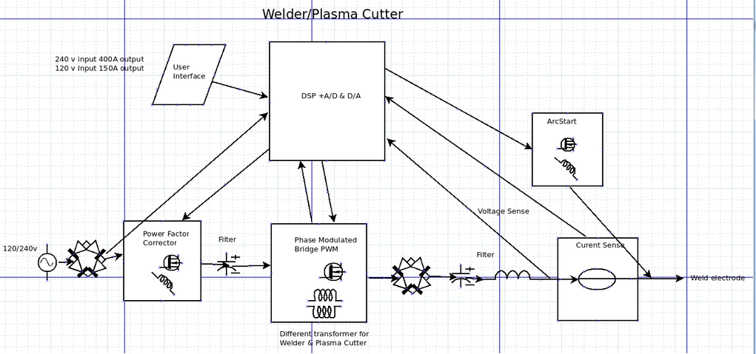
OSE Welder/Plasma Cutter
Schematic

Slide 12
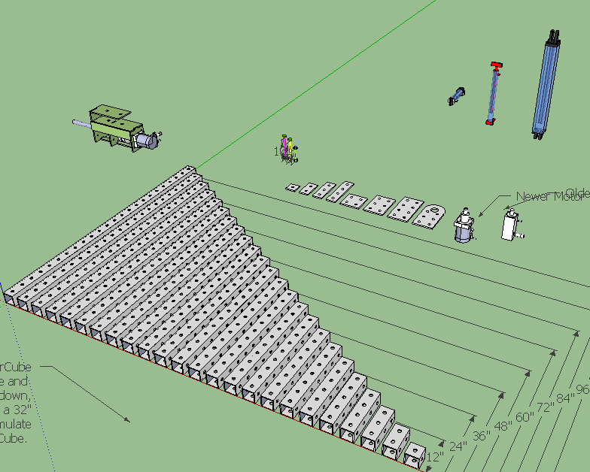

Slide 13
Summary
OSE Product development lacks 2 important elements:
Model Design Simulation and Testing
System Verification and Validation
META Tools used in combination with ISoC technologies not only provide solutions to these problems, but also enables you to quickly explore the entire Design Space.
We believe with these tools, OSE can reach its goals of scalability, quality design, and ultimately the means to SAVE THE WORLD.

Slide 14
Vanderbilt ISIS – OSE Joint Research Proposal
Scott and Jonathan continue to work collaboratively with OSE to optimize important modules
Short Term Goals
PowerCube – Design Space Exploration
Welder – System Verification
Long Term Goals
Establish OSE as a project partner with ISIS
Establish strong ties with Brigham Young and Vanderbilt University communities
Build Component, Module and System Library

