Slide 1
Open Source Island
Business Plan/Grant Proposal 2012

Slide 2
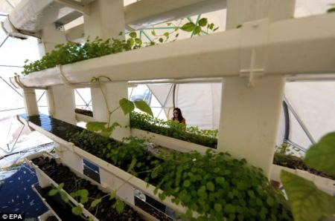
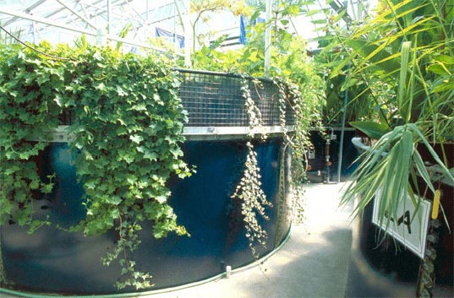
Index
Open Source Island, Island Foods, &
the Food Institute - Business Plan 2012
Mission Statement
The Market
Customers
Competition
Regulations
Management Team
Unique Assets
Financial Plan – First Five Years
Revenue
Financing
Cost Management
Business Resources
Milestones
Open Source Island & Island Foods
Joshua Pierce – 580-461-0352

Slide 3
Mission Statement
It is my goal to create a locally produced and distributed alternative to food choices that exist, while maintaining an absolute commitment to providing the highest quality organically certified produce grown in the most efficient and sustainable way without any chemicals or artificial fertilizers. In addition to food, customers will be engaged by interactive nutritional and sustainability information through classes, cook books, competitions, and events organized by the patronage.
Built around an individual operator which would be able to provide a sustainable job with a living wage serving around 80 people, each single operator unit could be hyper-modular and scalable allowing units to group together and form larger food co-ops with a greater diversity in food. Within the space of each unit there would be many different foods produced; It is my goal to investigate and cultivate every crop that can be produced in this system allowing for year-round access to locally produced seasonal food choices as well as conducting scientific research into Biology, Agriculture, Chemistry, Ecology, Nutrition, Sustainability, and public safety.
The profits from this organization will become collateral for projects determined by contributors and benefactors for the purpose of furthering research, community development, and access to education. Open Source Island will act as a revolving public trust to establish a sustainable infrastructure to serve the needs of the community.

Slide 4
Tax Entity – Non-Profit 501-C3 Public Charity/Private Foundation
Educational Institute – Aquaponic/Nutrition/Ecology/Sustainability
Scientific Research – Biology, Agriculture, Chemistry, Engineering, Ecology
Testing for Public Safety – Environmental Research/Monitoring
Relief for the Poor – Community Kitchens and Outreach
Advancement of Education – Scientific approach to accelerating competency model
Advancement of Science – Open Source research and development.
Maintaining/Building Public Monuments & Structures – Community/Environmental Stewardship though public works projects.
Community Revitalization – Reclaiming Industrial Space, creating neighborhood Gardens, Parks, Water and Waste Recycling Center

Slide 5
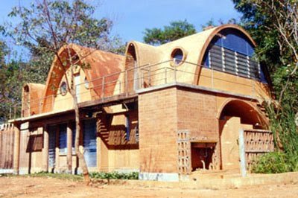
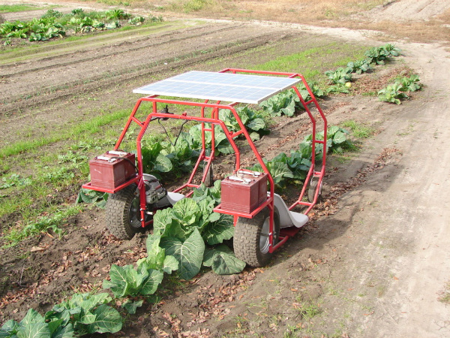
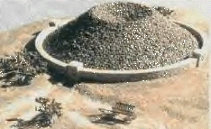
Products/Services
Restaurant/Grocer Urban/MicroFarms Locally Supported CSA Consumer, Worker, Agriculture Coop Nutrition/Aquaponics Education Open Source Ecology www.OpenSourceEcology.org | Sustainable Economic Development Green Earth Building Construction/Remodeling DIY Industrial Technology Solar/Wind & Geothermal Energy Online & Print Marketing/Publishing

Slide 6
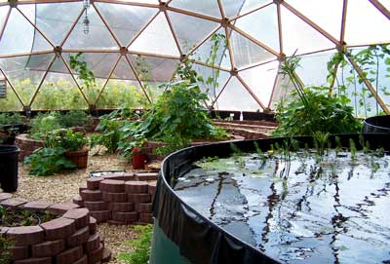
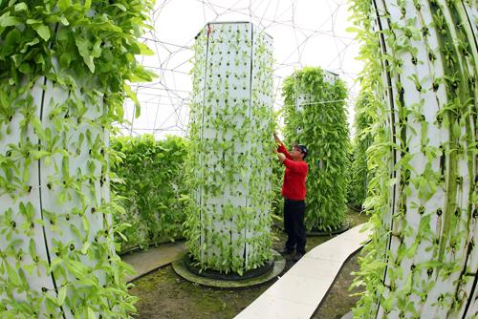
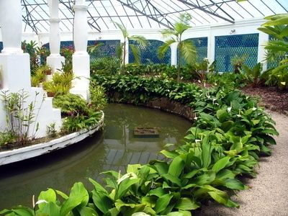
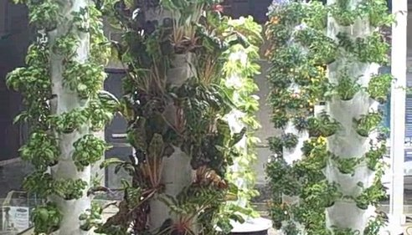
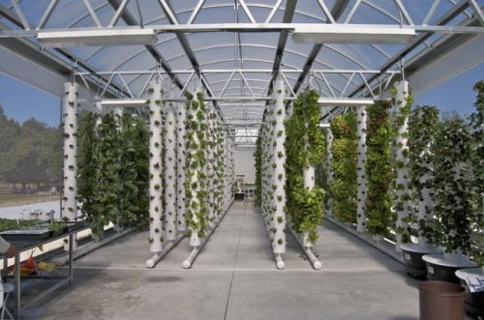
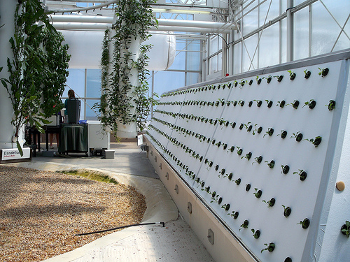
Island Foods & The Food Institute
Aeroponic/Aquaponic Food System
$5-$7 ft²
5-7 lbs/ft² Growing every month
www.friendlyaquaponics.com
Customer Outreach
Online & Print Publishing
Not just a business. It’s a movement!
Food for the Homeless
Backyard Aquaponics
Self Sufficient Schools
Self Sufficient Cities

Slide 7
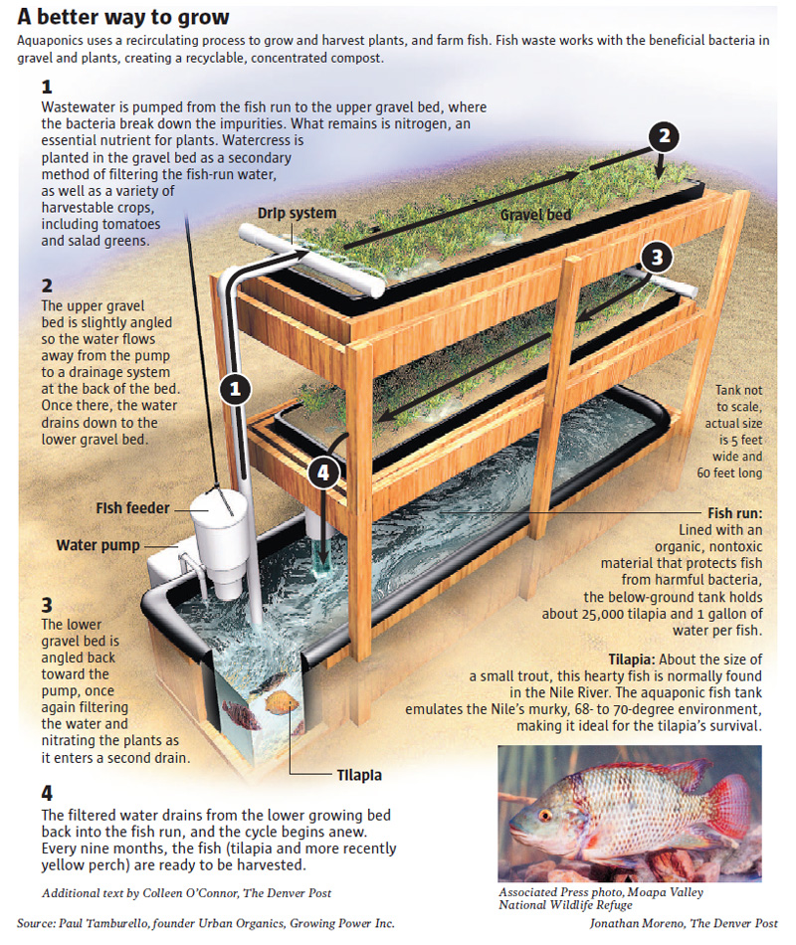
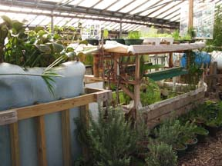
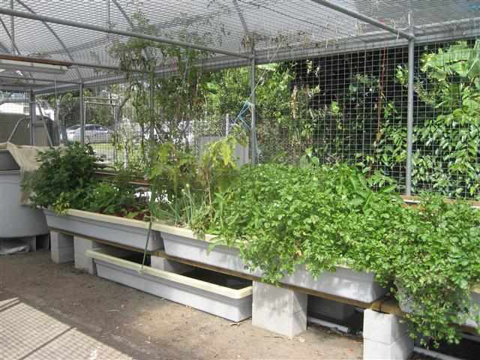

Slide 8
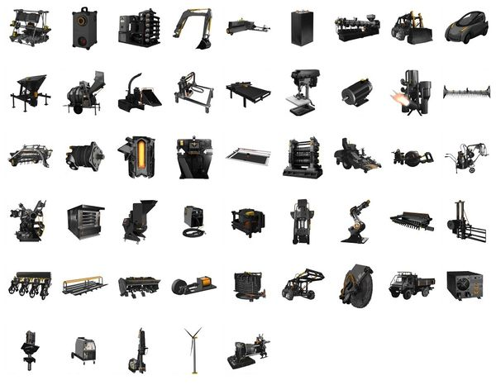
Open Source Island
Solar/Wind & Geothermal Energy
Construction/Remodeling
Green Earth Building
Online & Print Marketing/Publishing
Sustainable Economic Development
Urban/MicroFarms
Restaurant/Grocer
Consumer, Worker, Agriculture Coop
Locally Supported CSA
DIY Industrial Technology
Open Source Ecology
www.OpenSourceEcology.org
Open Source Ecology is accelerating the growth of the next economy - the Open Source Economy - an economy that optimizes both production and distribution - while promoting environmental regeneration and social justice. The Global Village Construction Set is a high-performance, modular, do-it-yourself, low-cost platform - that allows for the easy fabrication of the 50 different industrial machines that it takes - to build a small, sustainable civilization with modern comforts. By weaving open source permacultural and technological cycles together, we intend to provide basic human needs while being good stewards of the land, using resources sustainably, and pursuing right livelihood. With the gift of openly shared information, we can produce industrial products locally using open source design and digital fabrication. This frees us from the need to participate in the wasteful resource flows of the larger economy by letting us produce our own materials and components for the technologies we use. We see small, independent, land-based economies as means to transform societies, address pressing world issues, and evolve to freedom.

Slide 9
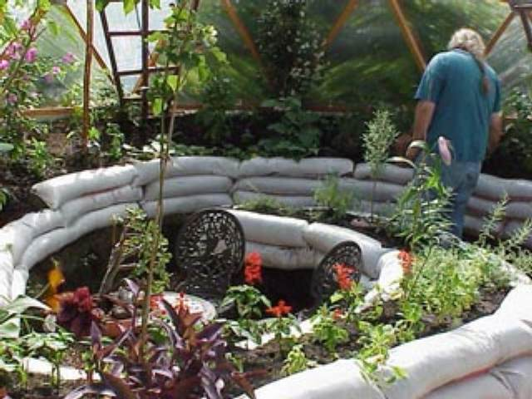
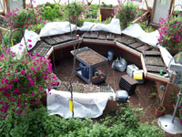
20’ Dome
 | sq ft | insulation | geenhouse
Base | 314
Surface | 628 | 40% | 60%
sq ft |  | 251.2 | 376.8
 | $ | Sq ft | sq ft, ft, # | Total
Wood Struts | 0.5 |  | 472 | 236
Polycarb Green House Pannel | 2 |  | 376 | 753
Hub Brackets | 10 |  | 46 | 460
bolts | 0.5 |  | 240 | 120
Diffusing Film | 1.68 |  | 376 | 631
Reflecting Film | 1 | 251.2 |  | 251
Concrete | 3 |  | 376.8 | 1130
Silicone | 0.5 |  | 472 | 236
Earthpipe | 30 |  | 30 | 900
Ceramic Paint Additive | 0.05 | 251.2 |  | 12
Paint | 0.2 | 251.2 |  | 50
Aquaponics System | 5 | 251.2 |  | 1256
Aeroponics System | 5 | 125.6 |  | 628
 | Total | $7,000 | $ 20 | per sq ft
Price |  |  | $ 1.00 |  | $ 3.00
Aeroponic | 377 |  | $ 376.80 |  | $ 1,130.40
Aquaponic | 251 |  | $ 251.20 |  | $ 753.60
Total Production | 628 | sq ft | $ 628.00 |  | $ 1,884.00
Months till Break Even ROI |  |  | 10 |  | 3

Slide 10
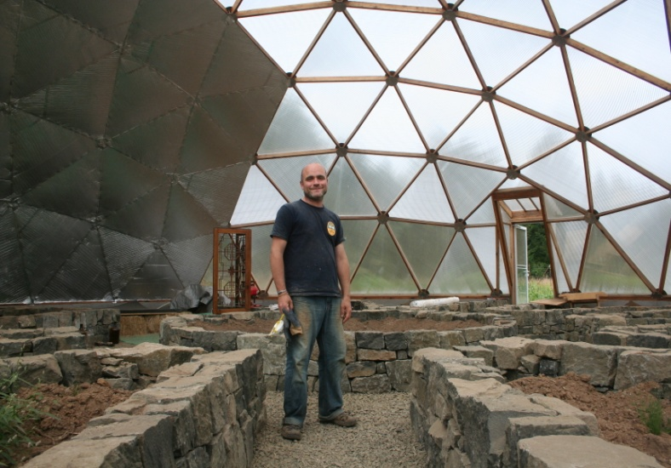
40’ Dome
 | sq ft | insulation | geenhouse
Base | 1257
Surface | 2513 | 40% | 60%
sq ft |  | 1005 | 1508
 | $ | Sq ft | sq ft, ft, # | Total
Wood Struts | 0.5 |  | 1494 | 747.00
Polycarb Green House Pannel | 2 |  | 1508 | 3,015.93
Hub Brackets | 20 |  | 45 | 900.00
bolts | 0.5 |  | 460 | 230.00
Diffusing Film | 1.68 |  | 1508 | 2,533.38
Reflecting Film | 1 | 1005 |  | 1,005.31
Concrete | 3 | 1508 |  | 4,523.89
Silicone | 0.5 |  | 1494 | 747.00
Earthpipe | 30 |  | 60 | 1,800.00
Ceramic Paint Additive | 0.05 | 1005 |  | 50.27
Paint | 0.2 | 1005 |  | 201.06
Aquaponics System | 5 | 1005 |  | 5,026.54
Aeroponics System | 5 | 503 |  | 2,513.27
 | Total | $23,293.65 | $18.54 | per sq ft
Price |  |  | $ 1.00 |  | $ 3.00
Aeroponic | 1508 |  | $ 1,507.96 |  | $ 4,523.89
Aquaponic | 1005 |  | $ 1,005.31 |  | $ 3,015.93
Total Production | 2513 | sq ft | $ 2,513.27 |  | $ 7,539.82
Months till Break Even ROI |  |  | 9 |  | 3

Slide 11
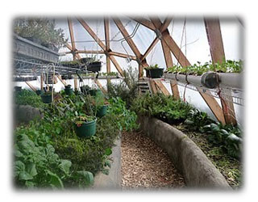
60’ Dome
 | sq ft | insulation | geenhouse
Base | 2827
Surface | 5655 | 40% | 60%
sq ft |  | 2262 | 3393
 | $ | Sq ft | sq ft, ft, # | Total
Wood Struts | 0.5 |  | 2190 | 1,095.00
Polycarb Green House Pannel | 2 |  | 3393 | 6,785.83
Hub Brackets | 20 |  | 60 | 1,200.00
bolts | 0.5 |  | 600 | 300.00
Diffusing Film | 1.68 |  | 3393 | 5,700.10
Reflecting Film | 1 | 2262 |  | 2,261.94
Concrete | 3 | 3393 |  | 10,178.75
Silicone | 0.5 |  | 2190 | 1,095.00
Earthpipe | 30 |  | 100 | 3,000.00
Ceramic Paint Additive | 0.05 | 2262 |  | 113.10
Paint | 0.2 | 2262 |  | 452.39
Aquaponics System | 5 | 2262 |  | 11,309.72
Aeroponics System | 5 | 1131 |  | 5,654.86
 | Total | $49,146.70 | $17.38 | per sq ft
Price |  |  | $ 1.00 |  | $ 3.00
Aeroponic | 3393 |  | $ 3,392.92 |  | $ 10,178.75
Aquaponic | 2262 |  | $ 2,261.94 |  | $ 6,785.83
Total Production | 5655 | sq ft | $ 5,654.86 |  | $ 16,964.59
Months till Break Even ROI |  |  | 9 |  | 3

Slide 12
Open Source Workshop
Basic Workshop $ 200
Amp MIG Welder $ 500
Acetylene Torch $ 400
Magnetic Drill $ 250
15 Amg and 5 Amp grinders $ 150
Allows tractor $ 6,000
CEB press $ 4,000
Pulverizer $ 800
2x Power Cube $ 4,000
Basic Advanced Workshop CNC Torch Tale $ 1,500
150Ton Ironworker $ 1,600
CNC Mill $ 4,000
CNC Lath $ 4,000
Heavy Duty Drill Press $ 600
Total $28,000

Slide 13
The Market
ORGANIC RESTURANTS -
Spiral Diner and Bakery Fairmount- Bakery, Vegetarian, Organic 1314 W Magnolia Ave
Good 2 Go Taco Lakewood - Breakfast/Brunch, Tacos, Organic 1146 Peavy Rd
Restaurant AVA Rockwall - Seafood, Wine Bar, Organic 108 S Goliad St
Kozy Kitchen Oak Lawn/Breakfast/Brunch, Desserts, Organic 4433 McKinney Ave
Potager Arlington - European, French, Organic 315 South Mesquite7
Yumilicious Allen - Desserts/Ice Cream, Kosher, Organic 190 E Stacy Rd Ste 1336
Dive Coastal Cuisine Park Cities - Sandwiches/Subs, Seafood, Organic 3404 Rankin
Buzzbrews Kitchen Oak Lawn/Uptown - American, Diner, Organic 4334 Lemmon Ave
Villa-O Oak Lawn/Uptown - Italian, Organic 4514 Travis St
Southpaw's Organic Cafe Park Cities - Subs, Smoothies, Organic 6009 Berkshire Lane
Jason's Deli Hulen Mall/Cityview - Subs, Soups, Organic 5100 Overton Ridge Blvd
Yumilicious Oak Lawn/ Desserts/ Kosher, Organic 3800 McKinney Ave Ste 160
Classic Cafe at Roanoke Roanoke - American, Seafood, Organic 504 N Oak St
Company Cafe East Dallas/Lakewood - American, Organic 2217 Greenville Ave
Yumilicious Plano - Desserts/Ice Cream, Kosher, Organic 1900 Preston Rd #337
Sfuzzi Uptown Oak Lawn/Uptown - Italian, Pizza, Organic 2533 McKinney Ave
Patina Green Home & Market McKinney - Subs, Vegetarian, Organic 116 n. Tennessee
The Life House Rockwall - Bakery, Coffee, Organic 506 N Goliad St
B's Texican Midlothian - Burgers, Tex-Mex, Organic 4470 E US 287
Smoothie Factory Coppell - Smoothies, Vegetarian, Organic 230 N. Denton Tap Rd
Southpaw's Organic Grill Oak Lawn, Subs, Organic, Salads 3227 McKinney Avenue
Bread Haus Grapevine - Bakery, Organic 700 W Dallas Rd
Tumbleweed Tea Room Justin - Coffee, Diner, Organic 100 West 3rd St
Wholesome Foods Bakery East Dallas/Lakewood - Bakery, Organic 718 N. Buckner
Texas Harvest Pie Company Keller - Bakery, Subs, Organic 124 S Main Street
Company Cafe Oak Lawn/ American, Breakfast/Brunch, Organic 3136 Routh Street
Coppell Bahama Beach Club Irving - Subs, Smoothies, Organic 1849 E Beltline Road
Beach Street Market Haltom City - Vegetarian, Organic 3789 n beach street
Zio Cecio Cucina Italiana North Dallas - Italian, Seafood, Organic 4615 W Lovers Ln
One2One Restaurant and Bar Frisco - American, Organic 1339 Legacy Dr
Avoca Coffee Fairmount/Coffee, Organic 1311 W. Magnolia Ave.
“When it comes to organic options outside supermarkets and natural-foods markets, Fort Worth and environs aren't exactly overflowing with options. Where in other cities, farmers markets are primary sources for local organic produce, you won't find any organic farmers at the Cowtown Farmers Market, the group of local farmers selling produce on Wednesday and Saturday mornings at the Benbrook Traffic Circle.
Ben Walker, president of the North Central Texas Farmers Market Corp., which operates the Cowtown market, says his group has just one organic farmer, who sells only at the Grapevine Farmers Market.” –
(http://rawfooddietsecrets.com/blog/24/organic-raw-food-produce-in-fort-worth-texas/)

Slide 14
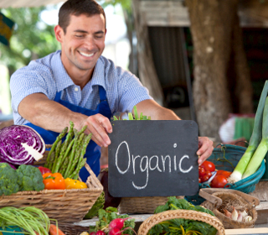
Customers
RODALE NEWS, EMMAUS, PA—A new poll looking at consumer preference regarding organic versus chemically grown food is enough to send shivers down the spines of industrial food execs. In the new Thomason Reuters–NPR health poll, the majority of people in every income range said they would prefer to eat organic food if given the choice. The greatest preference for organic comes from people age 35 and under, with those respondents citing the desire to support local farmers and the need to avoid toxic material in food as the top reasons for wanting organic.
THE DETAILS: Researchers polled about 3,000 people in early May to gather data indicating whether people prefer organic or chemically grown produce. (Food grown with synthetic chemicals is sometimes referred to as "conventional," but organic growing methods have been around a lot longer. So which method is really conventional?)
Nearly 60 percent of respondents said they'd prefer organic, if given a choice. About 45 percent of those people said they look to the local farmer's market to source organic food, followed by the grocery store (32 percent) and a home garden (20 percent).
While the majority in every age group said they prefer organic food, the 35-and-under age group showed the strongest support for organic, with about 63 percent opting for organic.
WHAT IT MEANS: It seems as though every week there's a new scientific study strengthening the case for organic, and this poll shows people are listening. Pesticides have been linked to ADHD, autism, obesity, Parkinson's disease, certain cancers, infertility, miscarriage, diabetes, and other ills. Aside from that, researchers have found that the most used pesticides are tainting not only our water supplies, but our food chain, as well. Systemic pesticides, such as the popular Roundup, are taken up inside of the plant, meaning we're often eating pesticides when we eat conventional food, even if we wash the produce beforehand.
organic poll
“Organic: You Know You Want It”
- A new poll shows people of all ages, but especially those under 35, want organic food. - Leah Zerbe

Slide 15
Growing Regions in Texas
Region 1 - West Texas
Counties Included: Andrews, Armstrong, Bailey, Borden, Brewster, Briscoe, Brown, Callahan, Carson, Castro, Childress, Cochran, Coleman, Collingsworth, Comanche, Crane, Crosby, Culberson, Dallam, Dawson, Deaf Smith, Dickens, Donley, Eastland, Ector, El Paso, Fisher, Floyd, Foard, Gaines, Garza, Glasscock, Gray, Hale, Hall, Hansford, Hartley, Haskell, Hemphill, Hockley, Howard, Hudspeth, Hutchinson, Jeff Davis, Jones, Kent, King, Knox, Lamb, Lipscomb, Loving, Lubbock, Lynn, Martin, Midland, Mitchell, Moore, Motley, Nolan, Ochiltree, Oldham, Parmer, Pecos, Potter, Presidio, Randall, Reeves, Roberts, Runnels, Scurry, Shackelford, Sherman, Stephens, Stonewall, Swisher, Taylor, Terrell, Terry, Throckmorton, Upton, Ward, Wheeler, Winkler, Yoakum.
Region 2 - North Texas
Counties Included: Anderson, Archer, Baylor, Bell, Bosque, Bowie, Camp, Cass, Cherokee, Clay, Collin, Cooke, Coryell, Cottle, Dallas, Delta, Denton, Ellis, Erath, Falls, Fannin, Franklin, Freestone, Grayson, Gregg, Hamilton, Hardeman, Harrison, Henderson, Hill, Hood, Hopkins, Hunt, Jack, Johnson, Kaufman, Lamar, Lampasas, Limestone, Marion, Mclennan, Milam, Mills, Montague, Morris, Navarro, Palo Pinto, Panola, Parker, Rains, Red River, Rockwall, Rusk, San Saba, Smith, Somervell, Tarrant, Titus, Upshur, Van Zandt, Wichita, Wilbarger, Wise, Wood, Young.
Region 3 - Gulf Coast
Counties Included: Angelina, Austin, Brazoria, Brazos, Burleson, Calhoun, Chambers, Colorado, Dewitt, Fort Bend, Galveston, Goliad, Gonzales, Grimes, Hardin, Harris, Houston, Jackson, Jasper, Jefferson, Lavaca, Leon, Liberty, Madison, Matagorda, Montgomery, Nacogdoches, Newton, Orange, Polk, Robertson, Sabine, San Augustine, San Jacinto, Shelby, Trinity, Tyler, Victoria, Walker, Waller, Washington, Wharton.
Region 4 - South Central Texas
Counties Included: Atascosa, Bandera, Bastrop, Bexar, Blanco, Burnet, Caldwell, Coke, Comal, Concho, Crockett, Dimmit, Edwards, Fayette, Frio, Gillespie, Guadalupe, Hays, Irion, Karnes, Kendall, Kerr, Kimble, Kinney, La Salle, Lasalle, Lee, Llano, Mason, Maverick, Mcculloch, Medina, Menard, Reagan, Real, Schleicher, Sterling, Sutton, Tom Green, Travis, Uvalde, Val Verde, Williamson, Wilson, Zavala
Region 5 - Valley
Counties Included: Aransas, Bee, Brooks, Cameron, Duval, Hidalgo, Hidalgo, Jim Hogg, Jim Wells, Kenedy, Kleberg, Live Oak, Mc Mullen, Mcmullen, Nueces, Refugio, San Patricio, Starr, Webb, Willacy, Zapata.

Slide 16
Currently Grown Organic Crops in Texas with Region
Alfalfa | 3,2 | Carrots | 2,3,4 | Fennel | 2,3,4 | Lettuce (Head) | 1,3,4 | Peppers | 4 | Salad Mixes | 1,2,3,4
Aloe Vera | 4,5 | Catnip | 3 | Fescue Grass | 1,3 | Lettuce (Leafy) | 1,3,4 | Peppers (Anaheim) | 3,4 | Savory | 2
Amaranth | 4 | Cauliflower | 3,4 | Figs | 2,3,4 | Marjoram | 2,4 | Peppers (Bell) | 2,3,4 | Sesame | 1
Apples | 4,2 | Celeriac | 4 | Flax | 2,4 | Melons (Misc.) | 2,4 | Peppers (Ceyenne) | 3,4 | Snow Peas | 4
Artichoke | 2,4 | Celery | 3,4 | Flowers | 1 | Millet | 2,4 | Peppers (Chili) | 3,4 | Sorghum | 1,2
Asparagus | 1,4 | Chervil | 2 | Garlic | 2,4 | Mint | 2,3,4 | Peppers (Habanero) | 3,4 | Sorrel | 2,4
Austrian Winter Peas | 2,4 | Chicory | 2 | Garlic (Elephant) | 2,4 | Mint Marigold | 4 | Peppers (Jalapeno) | 2,3,4 | Soybeans | 1,3,4
Avocados | 5 | Chinese Vegetables | 3,4 | Grain Sorghum | 1,3 | Mixed Vegetables | 1,2,3,4 | Peppers (Relleno) | 4 | Spinach | 1,3,4
Barley | 3 | Chives | 2,4 | Grapefruit | 5 | Mizuna | 2 | Peppers (Serrano) | 3,4 | Squash (Gourds) | 4
Basil | 2,3,4,5 | Cilantro | 4 | Grapes | 2,4 | Mushrooms (Shitake) | 2 | Peppers (Sweet) | 2,3,4 | Squash (Summer) | 1,2,3,4
Bay | 2 | Citrus | 4,5 | Grapes (Table) | 4 | Mustard Greens | 4 | Persimmon | 4 | Squash (Winter) | 3,4
Beans, Bush/Snap | 1,2,3,4 | Clover | 2 | Grapes (Wine) | 1,4 | Mustard Mix | 2 | Plums | 2,4 | Starfruit | 4
Beans, Fava | 4,4 | Clover (Red) | 3,4 | Grass/Forage Seeds | 4 | Nasturtium | 4 | Poppy | 4 | Straberries | 4
Beans, Long | 4 | Clover (Sweet) | 3,4 | Green Peas | 4 | Native Grasses | 1,2,3,4 | Potatoes (Red) | 2,3,4 | Sudan Grass Haygrazer | 1,3,4
Beans, Pinto | 3 | Collards | 2,3,4 | Guar | 1 | Native Grasses/Forages | 1,2,3,4 | Potatoes (Russet) | 2,4 | Sunflower Seeds | 3,4
Beans, Pole | 4 | Coriander | 4 | Hay | 2,3 | Oats | 1,4 | Potatoes Slips or Seed | 4 | Sunflowers | 3
Beets | 2,3,4 | Corn | 1,3 | Haygrazer | 1 | Okra | 1,2,3,4 | Potatos (Sweet) | 3 | Swiss Chard | 2,3,4
Bermuda Coastal | 2,3 | Corn (Blue) | 1 | Herb Seeds | 4 | Onions | 1,2,3,4 | Potatos (White) | 2,4 | Tangerines | 4
Bermuda Grass (Common) | 1,2 | Corn (Red) | 3 | Hibiscus | 3 | Onions (Green) | 2,3,4 | Pumpkins | 4 | Thyme | 2,4
Berries | 1,4 | Corn (White-Field) | 1,4 | Honey Dew | 5 | Oranges | 5 | Radish | 3,4 | Tomatoes | 1,2,3,4
Blackberries | 1,2,4 | Corn (White-Sweet) | 1,4 | Horshradish | 4 | Oregano | 2,3,4 | Radishes | 4 | Transplants | 4
Blackeyed Peas/Cow Peas | 1,2,3,4 | Corn (Yellow-Field) | 1,2,4 | Jicama | 4 | Papaya | 4 | Rice | 3 | Turnip | 2,3,4
Blueberries | 2,4 | Corn (Yellow-Sweet) | 2,3,4 | Kale | 2,3,4 | Parsley | 3,4 | Rice (Aromatic) | 3 | Vetch (Hairy-Winter) | 2,4
Bok Choi | 4 | Cotton | 1 | Kohlrabi | 3,4 | Parsnips | 4 | Rice (Long Gain) | 3 | Vetch (Purple) | 4
Broccoli | 3,4 | Cucumbers | 2,3,4 | Lavender | 4 | Pasture | 1,2,4 | Rice (Medium Grain) | 3 | Watermelon | 1,2,4,5
Brussel Sprouts | 4 | Dandelion | 3,4 | Leeks | 2,3,4 | Peaches | 1,2,4 | Rosemary | 2,3,4 | Wheat (Red) | 1,2,3,4
Buckwheat | 2,4 | Daikon | 4 | Lemon Balm | 4 | Peanuts | 1,4 | Rutabaga | 4 | Wheat (White) | 1,2
Cabbage | 2,3,4 | Dill | 3,4 | Lemon Grass | 2,4 | Pears | 2,4 | Rye | 1,4 | Wheatgrass | 4
Cactus | 1,4 | Eggplants | 2,3,4 | Lemon Verbena | 4 | Peas | 4 | Ryegrass | 1,3,4 | Yarrow | 4
Cantaloupe | 1,2,4 | Endive | 3,4 | Lemons | 5 | Pecans | 1,2,4 | Sage | 3,4 | Zucchini | 4

Slide 17
North Texas Organic Growers
Region 2 - North Texas
Counties Included: Anderson, Archer, Baylor, Bell, Bosque, Bowie, Camp, Cass, Cherokee, Clay, Collin, Cooke, Coryell, Cottle, Dallas, Delta, Denton, Ellis, Erath, Falls, Fannin, Franklin, Freestone, Grayson, Gregg, Hamilton, Hardeman, Harrison, Henderson, Hill, Hood, Hopkins, Hunt, Jack, Johnson, Kaufman, Lamar, Lampasas, Limestone, Marion, Mclennan, Milam, Mills, Montague, Morris, Navarro, Palo Pinto, Panola, Parker, Rains, Red River, Rockwall, Rusk, San Saba, Smith, Somervell, Tarrant, Titus, Upshur, Van Zandt, Wichita, Wilbarger, Wise, Wood, Young.
Albertson’s Distribution Center Aloe Commodities International, Inc. American Food Services Berry Best Farm Blueberry Ridge Farm Brookshire Grocery Company Dalusa Ranch Diamond J Farms Distant Lands Coffee Roaster Dogwood Gardens Organic Farm Dr. Kracker Dreamers Farms Inc. Fruit of the Earth Generation Farms Genes Greens, L.P. Good Earth Organic Farm Green Valley Food Corp Hardies Fruit and Vegetable Co, Inc Hart Magnolia House Hewett Orchards/Hewitt Ranch Hobbs Bonded Fibers Howard Terrell Improve USA Inc. James E Fischer Jolin’s Farm And Gardens Galore King's Crossing Farm Kwanawood Nature Farms L O Cattle Company | Lindley Farm LODC Inc. Minyard Distribution Center Morrison Organic Farm Navarro Pecan Co, Inc Oakridge Valley Farm Organics Ocean Spray Cranberries, Inc P. O. P Acres Ranch & Farm R & R Farms Rascoe Organic Pecan Orchard Rife Vineyards Rowdy Creek Farms Sesame Solutions LLC Sidney Kacir Ranch Sono Italiano T3R Cattle Terrell Farm Texas Bred Organic Meats Texas Organic Mushrooms Texas Organic Nursery The Little Farm The Little Farm Tree Grace Farms (Crandall Operation) Tree of Life Southwest White Oak Bayou Organic Farms Wolf Creek I & II /Crow Creek Farms

Slide 18
Organic Produces Prices - June 8, 2012
http://www.foodcoop.com/go.php?id=90
Name | Price | Origin
All other apples-minimally treated | $0.99 per pound | Hepworth Farms, NY
Aloe-organic | $3.07 each | USA
Artichokes-organic | $1.76 each | California
Arugula-cup, organic | $3.33 each | Remembrance Farm Trumansburg, NY
Arugula-twisties, organic | $1.90 per bunch | Locally grown within 500 miles
Arugula. | $0.71 per bunch | New Jersey
Asparagus-twisties organic | $4.37 per pound | New York
Asparagus. bunched | $2.75 per pound | Canada
Avocados-Hass, organic | $3.38 per pound | USA
Avocados-Hass. | $1.14 each | USA
Bananas-organic, loose or bags | $0.86 per pound | Ecuador Mexico Peru DR
Basil-label, organic | $1.95 per bunch | Locally grown within 500 miles
Basil. | $1.30 per bunch | New Jersey
Beans-fava, organic | $1.57 per pound | USA
Beans-green, bags organic | $4.46 each | USA
Beans-green. round. | $0.90 per pound | Florida
Beets- bunch, various, organic | $2.07 per bunch | Lancaster County, PA
Beets-chioggia, loose, organic | $2.47 per pound | USA
Beets-gold, loose, organic | $2.67 per pound | USA
Beets-red, loose, organic | $2.23 per pound | USA
Blackberries-organic | $3.94 each | Mexico or USA-read box/label
Blueberries-pint organic | $4.04 each | USA
Blueberries. pint | $2.65 each | USA
Bok Choy-baby, organic | $2.49 per pound | USA
Bok Choy-organic | $1.70 per pound | Locally grown within 500 miles
Broccoli-loose, organic | $1.58 per pound | Lancaster County, PA
Broccolini. | $2.29 per bunch | USA
Brussels sprouts-loose | $1.75 per pound | Mexico
Cabbage- Chinese nappa, organic | $1.34 per pound | Locally grown within 500 miles
Cabbage-green, organic | $0.89 per pound | USA
Cabbage-red, organic | $0.89 per pound | USA
Cabbage-savoy, organic | $1.34 per pound | USA
Cameo, minimally treated | $0.99 per pound | Hepworth Farms, NY
Carrots- bunch, orange, organic | $1.77 per bunch | USA
Carrots-1# bags, baby, organic | $1.33 each | USA
Carrots-1# bags, baby. | $1.05 each | USA
Carrots-1# bags, organic | $1.26 each | USA
Carrots-1# bags, regular | $0.56 each | Canada or USA (read label)
Carrots-25# bags, organic | $30.25 each | New York
Carrots-5# bags, organic | $6.07 each | USA
Carrots-loose orange, organic | $1.26 per pound | Hepworth Farms, NY
Cauliflower-white, organic | $1.60 per pound | USA
Celery Root (Celeriac)-organic | $1.53 per pound | USA
Celery-organic | $1.72 each | USA
Chard-various, organic | $1.67 per bunch | Locally grown within 500 miles
Chard-young, organic | $3.72 per pound | Lancaster County, PA
Cherries-red. | $4.89 per pound | USA
Chicory-organic | $1.57 per bunch | Lancaster County, PA
Cilantro-organic | $1.50 per bunch | Hepworth Farms, NY
Coconuts- organic | $1.18 per pound | Mexico
Coconuts-young Thai | $2.89 each | Thailand
Collards-bunch organic | $1.57 per bunch | Locally grown within 500 miles
Corn-organic | $0.94 each | Florida
Cucumber-Kirby. | $0.87 per pound | Florida
Cucumber-long seedless | $1.62 each | USA
Cucumber-Persian | $1.94 per pound | Dominican Republic
Cucumber-Persian, packaged, organic | $4.02 each | Mexico
Cucumber-regular, organic | $2.79 per pound | Mexico
Curry leaf-organic | $2.28 each | Florida
Daikon-organic | $1.31 per pound | USA
Dandelions-green or red organic | $1.87 per bunch | USA
Dill-organic | $1.87 per bunch | Locally grown within 500 miles
Eggplant-regular, organic | $2.54 per pound | Mexico or USA-read box/label
Empire, minimally treated | $0.99 per pound | Hepworth Farms, NY
Endive-Belgian | $2.31 per pound | Belgium or Holland
Escarole-, organic | $1.51 per pound | Locally grown within 500 miles
Fennel-twisties, organic | $3.16 each | Lancaster County, PA
Fennel. | $1.76 each | USA
Fiddlehead ferns-wild | $6.11 per pound | Locally grown within 500 miles
Fuji, minimally treated | $0.99 per pound | Hepworth Farms, NY
Gala-3lb bag, organic | $5.25 each | USA
Garlic Scapes-organic | $2.31 per pound | Locally grown within 500 miles
Garlic-label, organic | $3.78 per pound | Mexico
Garlic-spring, organic | $1.62 each | Locally grown within 500 miles
Garlic. | $2.26 per pound | Mexico

Slide 19
Organic Produces Prices - June 8, 2012
Ginger-organic | $4.80 per pound | Hawaii
Golden delicious, minimally treated | $0.99 per pound | Hepworth Farms, NY
Grapefruit-red, organic | $1.02 per pound | USA
Grapes-black seedless, organic | $3.37 per pound | USA
Grapes-green seedless organic | $4.85 per pound | Mexico
Grapes-red seedless, organic | $3.37 per pound | Mexico or USA-read box/label
Greens-baby beet, organic | $7.59 per pound | Hepworth Farms, NY
Greens-baby bok choy, green/red organic | $7.59 per pound | Hepworth Farms, NY
Greens-baby lamb's quarters, organic | $7.59 per pound | Hepworth Farms, NY
Greens-baby mizuna, organic | $7.59 per pound | Locally grown within 500 miles
Greens-baby yu choy, organic | $7.59 per pound | Hepworth Farms, NY
Herbs-bag, organic local | $1.91 per bunch | Locally grown within 500 miles
Herbs-bag. | $1.04 each | Colombia or Palestine
Herbs-chives organic local | $2.48 each | Locally grown within 500 miles
Herbs-cup, organic | $2.12 each | Locally grown within 500 miles
Horseradish-trimmed, organic | $4.97 per pound | Lancaster County, PA
Jicama. | $0.88 per pound | Mexico
Jonagold, minimally treated | $0.99 per pound | Hepworth Farms, NY
Kale-green curly, bunch organic | $1.67 per bunch | Locally grown within 500 miles
Kale-lacinato, bunch organic | $1.97 per bunch | Locally grown within 500 miles
Kale-purple stem, organic | $1.67 per bunch | Locally grown within 500 miles
Kiwi-label, organic | $0.47 each | New Zealand
Kiwi. | $0.36 each | New Zealand
Kohlrabi-bunch, organic | $2.33 per bunch | Locally grown within 500 miles
Kohlrabi-loose, organic | $2.00 per pound | Locally grown within 500 miles
Kumquats- organic | $3.76 per pound | USA
Leeks-organic | $1.76 per pound | USA
Lemon Grass. | $4.43 per pound | USA
Lemons-label, organic | $2.01 per pound | USA
Lemons. | $0.30 each | USA
Lettuce-baby mix, organic | $2.60 per pound | Hepworth Farms, NY
Lettuce-Boston, organic | $1.76 per pound | Locally grown within 500 miles
Lettuce-green leaf, organic | $1.76 per pound | Locally grown within 500 miles
Lettuce-red leaf, organic | $1.76 per pound | Locally grown within 500 miles
Lettuce-romaine hearts, organic package | $2.53 each | USA
Lettuce-romaine, organic | $1.26 per pound | Locally grown within 500 miles
Limes-label, organic | $1.66 per pound | USA
Limes. | $0.12 each | Mexico
Lychees | $4.51 per pound | Mexico
Mangoes-, organic | $1.59 per pound | Mexico
Melons-canary, organic | $1.14 per pound | USA
Melons-cantaloupe, label organic | $1.30 per pound | USA
Melons-cantaloupe. | $1.11 per pound | USA
Melons-honeydew, organic | $1.34 per pound | Mexico or USA-read box/label
Melons-honeydew,. | $3.85 each | Mexico or USA-read box/label
Micro Mix 1.6 oz cup organic | $3.74 each | Hepworth Farms, NY
Mint- organic twisties | $2.13 per bunch | Locally grown within 500 miles
Mint. | $1.42 per bunch | New Jersey
Mizuna-organic | $1.87 per bunch | Locally grown within 500 miles
Mushroom-eryngii, (king trumpet) organic | $3.64 each | USA
Mushroom-maitake bag, organic | $2.53 each | USA
Mushroom-maitake cup, organic | $3.55 each | Locally grown within 500 miles
Mushrooms-cremini, organic | $3.29 per pound | Pennsylvania
Mushrooms-portobello, organic | $4.53 per pound | Pennsylvania
Mushrooms-shiitake, organic | $7.74 per pound | Pennsylvania
Mushrooms-white, cups, organic | $1.76 each | Pennsylvania
Mushrooms-white, loose, organic | $2.88 per pound | Pennsylvania
Mustards-green or red, organic | $1.27 per bunch | Locally grown within 500 miles
Mutsu, minimally treated | $0.99 per pound | Hepworth Farms, NY
Okra. | $1.78 per pound | Florida
Onion-Vidalia or organic label | $1.14 per pound | Georgia
Onion.-Vidalia or yellow label | $0.95 per pound | Georgia
Onions- 3 lb bags. | $1.42 each | USA
Onions- organic, no label | $1.24 per pound | Locally grown within 500 miles
Onions-red, label, organic | $1.27 per pound | Locally grown within 500 miles
Onions-red. | $1.07 per pound | USA
Onions-spring bunch, organic | $1.87 per bunch | Locally grown within 500 miles
Oranges-California valencia, organic | $0.76 per pound | California
Oranges-Florida valencia, organic | $0.99 per pound | Florida
Oranges-navel, Sunkist or PLU 3107 | $1.03 per pound | California
Papaya.-red flesh | $1.50 per pound | Mexico
Parsley-curly, organic twistie | $1.28 per bunch | Locally grown within 500 miles
Parsley-plain, organic twistie | $1.68 per bunch | USA
Parsley.-curly. | $0.45 per bunch | New Jersey
Parsley.-plain. | $0.63 per bunch | New Jersey
Parsnips-organic | $1.80 per pound | USA
Peaches-donut, organic | $5.82 per pound | USA
Peaches-yellow, label organic | $3.56 per pound | USA
Peaches. PLU#4403 | $1.07 per pound | South Carolina
Pears-Asian. | $1.54 each | USA OR Chile
Pears-bosc, organic | $1.67 per pound | Argentina
Peas-in the pod, organic | $2.47 per pound | Hepworth Farms, NY

Slide 20
Organic Produces Prices - June 8, 2012
Peas-snow. | $2.67 per pound | Guatemala or Peru
Peas-sugar snap, organic | $3.72 per pound | Hepworth Farms, NY
Pecans in the shell, organic | $1.24 per pound | Missouri
Peppers-cherry hot, organic | $5.58 per pound | Mexico
Peppers-green, label organic | $3.13 per pound | USA
Peppers-green. | $0.97 per pound | Florida
Peppers-jalapeno. | $0.79 per pound | Georgia
Peppers-orange. | $3.09 per pound | Canada or Mexico
Peppers-poblano. | $1.70 per pound | Mexico
Peppers-red, label organic | $4.44 per pound | Holland or Mexico (read label)
Peppers-red. | $1.41 per pound | Mexico
Peppers-serrano | $2.19 per pound | Mexico
Peppers-shishito | $5.09 per pound | Mexico
Peppers-sweet mini cups, organic | $2.99 each | Mexico
Peppers-yellow, label organic | $4.44 per pound | Holland
Peppers-yellow. | $1.77 per pound | Mexico
Pineapple-gold, organic | $3.65 each | Costa Rica or Ecuador
Pineapple.-gold type | $2.28 each | Costa Rica
Platanos- label, organic | $1.20 per pound | Mexico
Platanos-green (plantains) | $0.63 per pound | Ecuador
Platanos-yellow (plantains) | $0.75 per pound | Colombia
Potato- 5lb bag russet, organic | $4.79 each | Canada or USA (read label)
Potatoes-fingerling, organic | $2.25 per pound | USA
Potatoes-red, organic | $1.00 per pound | Hepworth Farms, NY
Potatoes-yukon gold, organic | $1.00 per pound | Hepworth Farms, NY
Radicchio-organic | $6.32 per pound | Lancaster County, PA
Radish-loose, organic | $3.76 per pound | Locally grown within 500 miles
Radishes-bunch, organic | $1.87 per bunch | Locally grown within 500 miles
Raspberries-red, organic | $3.04 each | Mexico or USA-read box/label
Red delicious, organic | $1.50 per pound | USA
Rhubarb-organic | $3.21 per pound | USA
Salad Mix- 16oz bags, organic | $5.45 each | USA
Salad Mix- loose, organic | $5.89 per pound | USA
Salad-spicy greens, 5oz cup organic | $3.33 each | Remembrance Farm Trumansburg, NY
Salad-spring mix/baby greens 5oz organic | $3.33 each | Mexico or USA-read box/label
Scallions-organic | $0.85 per bunch | Locally grown within 500 miles
Scallions. | $0.48 per bunch | Mexico
Shallots- cup, label, organic | $2.50 each | USA
Shallots. | $1.20 per pound | France
Spinach- bunch, organic | $1.87 per bunch | Hepworth Farms, NY
Spinach- loose, organic | $4.12 per pound | Locally grown within 500 miles
Spinach-baby, 16 oz, organic | $5.45 each | USA
Spinach-baby, 5oz, organic | $3.33 each | USA
Spinach-bagged | $2.13 each | Locally grown within 500 miles
Sprouts-alfalfa, organic | $1.24 each | Locally grown within 500 miles
Sprouts-bean (mung), organic | $1.59 each | Locally grown within 500 miles
Sprouts-broccoli, organic | $2.17 each | Maryland
Sprouts-crunchy/mix bean organic | $1.85 each | Locally grown within 500 miles
Sprouts-garden, pesticide-free | $1.85 each | Locally grown within 500 miles
Sprouts-spicy, organic | $1.48 each | Locally grown within 500 miles
Sprouts-sunflower, 16oz organic | $10.25 each | New York
Sprouts-sunflower, 4oz organic | $3.39 each | New York
Sprouts-sweet pea shoots, organic | $3.03 each | Locally grown within 500 miles
Squash-butternut, organic | $1.59 per pound | Mexico
Squash-kabocha, organic | $1.59 per pound | Mexico
Squash-yellow, organic | $2.09 per pound | Locally grown within 500 miles
Squash-zucchini, organic | $2.23 per pound | Locally grown within 500 miles
Stayman winesap, minimally treated | $0.99 per pound | Hepworth Farms, NY
Strawberries-1 lb box, organic | $3.80 each | USA
Strawberries-open pint local organic | $3.64 each | Locally grown within 500 miles
Strawberries-quart basket, organic | $5.31 each | Hepworth Farms, NY
Sweet potato- Japanese, organic | $1.34 per pound | USA
Sweet potato- Jewel, organic | $1.34 per pound | USA
Sweet potato- Red garnet, organic | $1.34 per pound | USA
Sweet potato-any organic | $1.34 per pound | USA
Tomatillos. | $0.88 per pound | Mexico
Tomato Grape, Lady Moon organic | $3.34 each | Lady Moon Farm, Florida
Tomato Grape. | $2.03 each | Florida
Tomatoes-. organic | $2.51 per pound | Mexico or USA-read box/label
Tomatoes-plum, organic | $1.53 per pound | Mexico or USA-read box/label
Turmeric-organic | $9.43 per pound | Hawaii
Turnips-Japanese, organic | $2.93 per bunch | Locally grown within 500 miles
Turnips-various, loose, organic | $1.51 per pound | Locally grown within 500 miles
Vegetable-potted 4 pack, organic | $2.89 each | Markristo Farm-Hillsdale, New York
Watercress-upland type pesticide-free | $2.13 each | USA
Watermelon-red seedless, organic | $0.68 per pound | USA
Wheatgrass-1 lb bags, organic | $13.27 each | Locally grown within 500 miles
Wheatgrass-tray, organic | $18.27 each | Locally grown within 500 miles
Yuca (manioc or cassava) | $0.61 per pound | Costa Rica

Slide 21
Organic Producers in Texas
Name | Address | City | Zip | Phone
3-H Farms | BOX 1455 | Bay City | 77414 | 979-240-8499
Aaron Vogler Farms | 2202 CR S/ Box 1012 | Lamesa | 79331 | 806-497-6400
Aloe Farms Inc | 3102 Wilson Rd | Harlingen | 78552 | 956-425-1289
Aloe Laboratories Inc | Box 831 | Harlingen | 78550 | 956-428-8416
Angel Valley Organic Farm | 18405 Angel Valley Dr | Leander | 78641 | 512-267-2785
Ashley & Shane Waller Farms | BOX 848 | China | 77613 | 409-752-7436
Assisi Farms | BOX 886 | Gonzales | 78629 | 830-672-5738
Azrasun Organic Farms | 1226 County Road 108 | Floresville | 78114 | 210-367-0790
B & B Joint Venture | 668 Sweetwater | Port Lavaca | 77676 | 361-552-5404
B & K Holubec | HC-34 BOX 132 | Midkiff | 77955 | 432-686-8351
Bassman Fresh Inc | 678 CR 2178 | Cleveland | 77327 | 713-854-0479
Benjamin David Franklin | Box 556 | O'Donnell | 79351 | 806-428-3898
Berry Best Farm | 12462 FM 2588 | Larue | 75770 | 903-677-3448
Blueberry Ridge Farm | BOX 804 | Mineola | 75773 | 972-567-9357
Boggy Creek Farm | 3414 Lyons Road | Austin | 78702 | 512-926-4650
Buena Tierra | 399 CR 383 | Fredonia | 76842 | 325-429-6301
Carl Pepper Farms | Rt 1 Box 101 A | O'Donnell | 79351 | 806-439-6336
Cecil Slack Farms | 10203 Duncan Rd | Beaumont | 77713 | 409-752-5524
Chickamaw Farm | Box 787 | Mcdade | 78650 | 512-321-4449
Christopher and Judith Grotegut | 4419 Co Rd 13 | Hereford | 79045 | 806-258-7565
Cimarron Organics | 7122 Bluebonnet | Amarillo | 79108 | 806-383-1366
Clover Hill Farms | 500 Capital of Texas Hwy N. Bldg. 3 ste 100 | Austin | 78746 | 512-328-9090
CMB Resources | Box 1488 | Frederiksburg | 78624 | 830-997-3856
Cornelius Crawfish | Box 288 | Wadsworth | 77483 | 979-245-4390
Cornelius Rice | Box 288 | Wadsworth | 77483 | 979-245-4390
Coyote Creek Farm | 13431 Klaus Ln | Elgin | 78621 | 512-940-6523
Curtis Hutchinson | 108 FM 2035 | Sweetwater | 79556 | 915-235-1164
D & S Farms, Inc | 107 S. Cheryl | Brownfield | 79316 | 806-636-1478
Dalusa Ranch | 2755 Rains City rd 1490 | Point | 75472 | 903-598-6822
Dennis Holubec | HC 34 Box 132 | Midkiff | 79755 | 432-686-8351
Dogwood Gardens Organic Farm | Bod 254 | Ben Wheeler | 75754 | 903-833-1024
Double A Farms | HC 62 Box 26 | El Campo | 77437 | 979-541-6411
Dr Dirt Organic Productions | 5802 Rising Hills Dr | Austin | 78759 | 512-784-5987
Dreamers Farms Inc. | 23810 Lakeside Dr | Marbel Falls | 78654 | 254-248-1841
Eddie Bingham Farms | Rt 1 Box 90 | Meadow | 79345 | 806-585-6365
Emery Farms | Rt 3 Box 184 | Lubbock | 79403 | 806-746-5913
F & R Custom Farms, Inc | Box 1536 | Seminole | 79360 | 432-758-119
Finca Pura Vida LLC | 944 Lakeview Rd | Fayetteville | 78940 | 979-249-3866
Forever Aloe Plantations | 25649 N Tamm Ln | Harlingen | 78552 | 956-425-2585
Forrest Herman Perry | Box 816 | Van Horn | 79855 | 915-283-1923
Gearhart Farm | 8017 n Ware | Mc Allen | 78504 | 956-686-8654
Generation Farms | 1109 N McKinney St | Rice | 75155 | 903-326-4263
Gene's Greens, L.P. | 6105 Remington Pkwy | Colleyville | 76304 | 817-301-3521
Glen Marecek | Box 222 | Midkiff | 79755 | 915-535-2351
Goebel Organics Inc. | 3508 Irving Ave | Snyder | 79549 | 915-728-3630
Good Earth Organic Farm | 8629 FM 272 | Celeste | 75423
Montesino Farms | Box 1871 | Wimberly | 78676 | 512-847-7393
Morrison Organic Farm | 4000 FM 3136 | Cleburne | 76031 | 817-645-2080
Morrison Ranch | 1400 Morrison Ranch RD | Pampa | 79065 | 806-663-3124
Nathan Lane Brewster | Box 1003 | Van Horn | 79855 | 915-2841200
Natural Prairie Dairy Farms | Box 659 | Hartley | 79044 | 806-365-4189
Natural Prairie Organic | Box 659 | Hartley | 79044 | 806-244-0152
Northrup Ranch, Inc | Box 63356 | Pipe Creek | 78063 | 830-535-4024
Oakridge Valley Farm Organics | 540 FM 773 | Grand Saline | 75140 | 903-962-4452
Oasis Gardens | 7651 Delwau Ln | Austin | 78725 | 512-386-7636
Onion Creek Farm | 1611 Creek Rd | Dripping Springs | 78620 | 512-858-1090
Oportunidads Golpe Inc | Rt 1 Box 72 | Meadow | 79345 | 806-585-6557
Orange Blossom Farm | Rt 1 Box 94A | Carizo Springs | 78834 | 830-876-2103
Organic Farms of Texas | H.C.R. 62 Box 154C | El Campo | 77437 | 979-543-2222
Organic Vertical Acre | Box 670 | Kingsland | 78639 | 325-388-6968
P.O.P. Acres Ranch & Farm | 8040 FM 642 | Purdon | 76679 | 903-673-1435
P/2 Organic | 301 CR 461 | Coupland | 78615 | 512-281-4712
Pat's Veggies Organic Farm | 3950 and 3003 Stategoach Rd | Seguin | 78155 | 830-914-3756

Slide 22
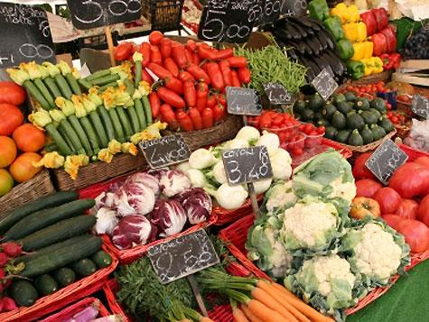
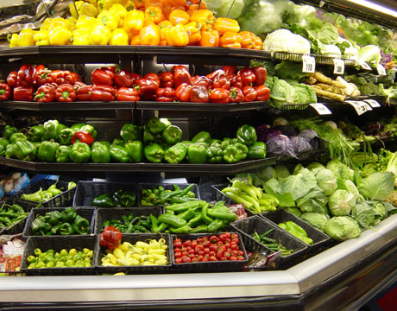
Organic Producers in Texas
Pierce Ranch | Box 538 | Pierce | 77467 | 979-532-4250
Pure Luck Texas | 101 Twin Oaks Trail | Dripping Springs | 78620 | 512-858-7034
R & R Farms | 7445 Bear Lake Dr | Fort Worth | 76137 | 817-909-3519
Ralph Diller Farms | 4101 County Rd 14 | Hereford | 79045 | 806-258-7392
Ralph Hoelscher | 14446 East Arlington RD | Miles | 76861 | 915-468-2592
Ranch Dickens-Armentrout Organics | 1715 Horton Preiss Rd | Blanco | 78606 | 830-833-2270
Rascoe Pecan Orchard | 1864 Beverly Cox Dr | Waco | 76702 | 254-799-3334
Rife Vineyards | 154 Moonlight Dr | Murphy | 750943 | 972-422-7658
Rigoberto Delgado | 3751 Carlon St | Houston | 77005 | 713-899-3206
Ronda's Montessori Garden | 4600 Mount Vernon Dr | Austin | 78745 | 512-707-8635
Rowdy Creek Farms | Rt 1 Box 52 | Roxton | 75477 | 972-346-3492
Ryan Farm | 16415 Hornet Creek | San Antonio | 78247 | 915-559-1725
S & O Farms | Box 1301 | Seagraves | 79359 | 806-637-1478
S O S From Texas | Box 767 | Samnorwood | 79077 | 806-256-2749
Scott Arbor | 625 Old Woehler Rd | Seguin | 78155 | 210-379-0588
Shea Floyd Farms | 1814 E. Buckle | Brownfield | 79316 | 806-759-6555
SHS Farms Inc. | 2750 Rait Rd | Friona | 79035 | 806-346-0649
Sidney Kacir Ranch | Box 5119 | Temple | 76505 | 254-773-2173
Smith Land & Cattle | Box 430 | Hart | 79043 | 806-938-2110
Solomon Farm | Box 196 | Vega | 79092 | 806-344-2954
South Loop Land And Cattle Lc | 2934 Rigsby Ave | San Antonio | 78222 | 210-333-5753
South Tex Organics Lc | 1504 Betty Drive | Mission | 78572 | 956-585-1040
Spiral Sprouts Of Houston | Box 5295 | Kingwood | 77325 | 281-356-5311
St. Jude's Hydroponics Garden | 1501 Tara Court | College Station | 77840 | 979-324-6040
Stephanie Lanford Farms | Box 1301 | Seagraves | 79359 | 806-637-1478
Steven Goetsch Farms | Rt 2 Box 176 | El Campo | 77437 | 979-513-5038
Sustainable Agronomic Education Association | Rt 25 Box 120 | Edinburg | 78541 | 956-821-8875
SWT Cattle, LLC | 1304 Mariposa Drive #211 | Austin | 78704 | 512-416-0400
T3R Cattle | HC 63 Box 35AB | Mullin | 76864

Slide 23
Competition

Slide 24
Regulations
Friendly Aquaponics
“Our systems are USDA Organically Certified and our produce is organic.”
(http://www.usda.gov/wps/portal/usda/usdahome?navid=ORGANIC_CERTIFICATIO)
Organic Certification
National Organic Program (NOP)
USDA's National Organic Program regulates the standards for any farm, wild crop harvesting, or handling operation that wants to sell an agricultural product as organically produced.
National Organic Program
Accredited Certifying Agents
Regulation
Policies
Organic Information for Producers, Handlers, Processors, and Retailers
State and Cost Share Program
Organic Labeling for Consumers
The National Organic Program and the Organic Foods Production Act are intended to assure consumers that the organic foods they purchase are produced, processed, and certified to be consistent with national organic standards.
Consumers
Organic Labeling and Marketing Fact Sheet
Organic Farming Production and Marketing
U.S. producers are turning to certified organic farming systems as a potential way to lower input costs, decrease reliance on nonrenewable resources, capture high-value markets and premium prices, and boost farm income. Organic farming systems rely on ecologically based practices such as cultural and biological pest management, exclusion of all synthetic chemicals, antibiotics, and hormones in crop and livestock production.
Organic Farming and Marketing
Organic Agriculture Provisions
U.S. Organic Farming Research
Organic Food Production
Export and Import of Organic Products
The National Organic Program, has several agreements in place with other countries to facilitate trade of U.S. organic products while also ensuring a consistent supply of organic products for U.S. markets.
International Agreements

Slide 25
Financial Plan – 5 years
Loan: $ 120,000 120,000
Term: 5 years (60) months 10 year (120) month
Interest rate: 6% 6%
Calculated Monthly Payment: $ 2,319.94 $1,332.25
Estimated Monthly Revenue: $ 4,000 - $6,000 $ 4,000 - $6,000
Monthly Operating Cost: $ 400 $ 400
Estimated Net Month Profit: $1,280-$3,280 $2,267-$4,267
Estimated Annual Income: $15,360-$39,360 $27,204-$51,204
Market Potential 4000 ft²: $20,000/mo. or $240,000/yr.
Investor Returns – 6%

Slide 26
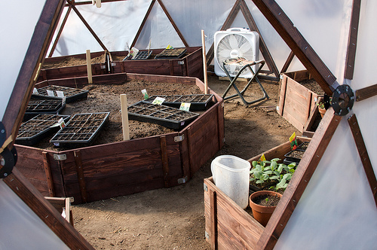
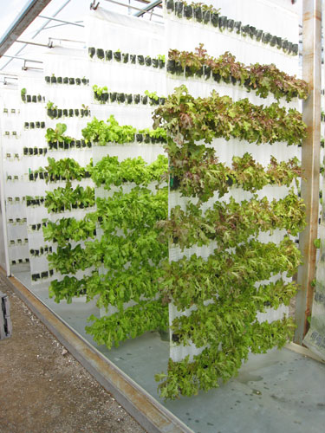
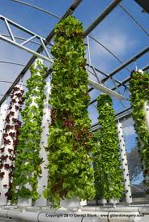
Start Up Cost Worksheet
Permits |  | 5,000
Certifications |  | 1,500
Equipment – 60’ ft Dome |  | 50,000
Electrical |  | 5,000
Well |  | 3,000
Land |  | 2,500
Taxes |  | 1,500
Insurance |  | 1,200
Surety Bond |  | 1,000
3 Months Opperating Cost |  | 3,750
 | TOTAL | $ 74,450

Slide 27
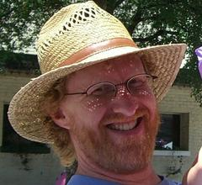
Business Resources
Business Coaches
Dennis Wagner (214) 758-7582 Visit Website North Texas
Stephen Marino 972 709 6776 Visit Website North Texas
Doug Winnie 17139363814 Visit Website South Texas
Jim Ambler 972-712-0229 Visit Website North Texas
Kim Jaggard 512 586 5640 Visit Website South Texas
Michael Rager 713-936-3814 Visit Website South Texas
Trey Finley 972-979-3761 Visit Website North Texas
Max Kozlovsky (210)880-5690 Visit Website South Texas
Rich Allen 214-758-7581 Visit Website North Texas
Bart deJong 281-602-8030 Visit Website South Texas
Kirby Kaden 210.410.1233 Visit Website South Texas
Carlos Zubillaga 210 822-2444 Visit Website South Texas
Judi Alft 480-968-9705 Visit Website South Texas
Kevin Smith (936) 649-0886 Visit Website South Texas
Tammy Gentry 210-723-9599 Visit Website South Texas
Kevin Alft 480-968-9705 Visit Website South Texas
Malcolm Upton (817) 237-4693 Visit Website North Texas
Aquaponic Groups and Gurus
Dave Pennington – Richardson, TX
DFW AQUAPONICS
http://www.meetup.com/The-Dallas-Aquaponics-Meetup-Group/
http://aquaponicscommunity.com/profile/DavePennington

Slide 28
Management Team
Joshua Pierce – CEO
Jeff Johnson – Business Consultant
Melissa Johnson – Nutrition Consultant
Dave Pennington – Aquaponics Consultant
James Pierce – Marketing/CFO
Crystal Lindstrom – Architect/Designer
Carrie Greesley – Botanist/Science Advisor
Fred Hintergardt – Contractor
Jeremy Kulow – Intern

Slide 29
Contact
Joshua Pierce
416 Fieldstone Ln. Venus, TX 76084
Pierce.JoshuaT@Gmail.com
580-461-0352

Slide 30
